Slide 1
GOSH Data interchange for sensors classifications

Slide 2
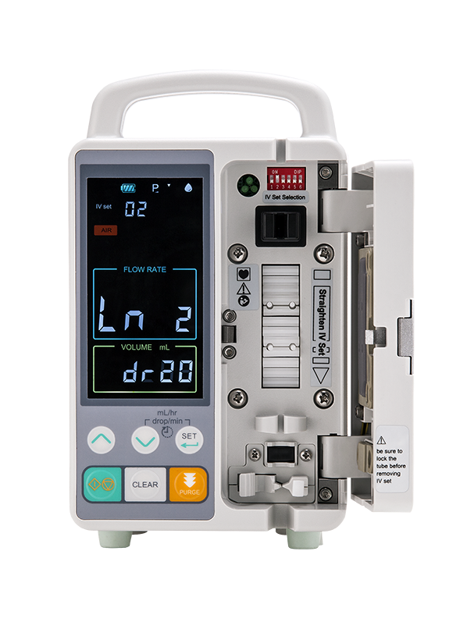
MOTIVATION
Infusion Pumps deliver nutrients and medications into a patient's body in controlled amounts.
Portable Infusion Pumps are also being used to treat patients at home.
Since infusion Pumps are used to administer critical fluids, including high-risk medications, pump failures can have significant implications for the patient safety.
Sensors are key components in controlling and monitoring infusion pumps.
They monitor fluid flow and volume, provide occlusion detection and, in some cases, the temperature of the fluid.
Therefore, sensors must be reliable, accurate, fast and compact in size.

Slide 3
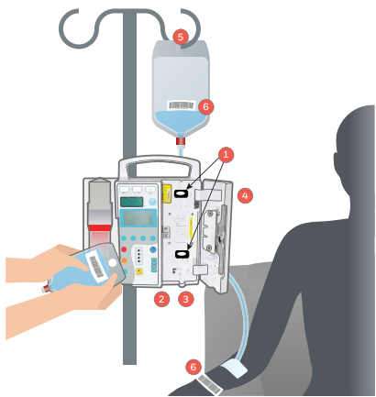
SENSORS
1.Force Sensor
Make sure the fluids can deliver to the patients by detecting if there any blockages.
2.Pressure Sensor
Monitors and control the pressure of peristaltic pumps
3.Magnetic Position Sensor
Monitor the velocity and orientation of motors and make sure the motor is under control
4.AML switches
On/Off switches and to identify open panels
5.Subminiature Load Cells
Keeps track of the weight of the IV bag
6.Barcode Scan Engines
Scans barcodes on IV bags and patient wrist bands

Slide 4
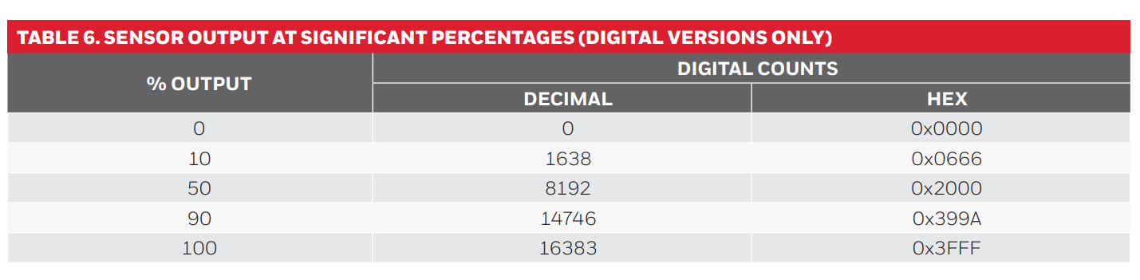
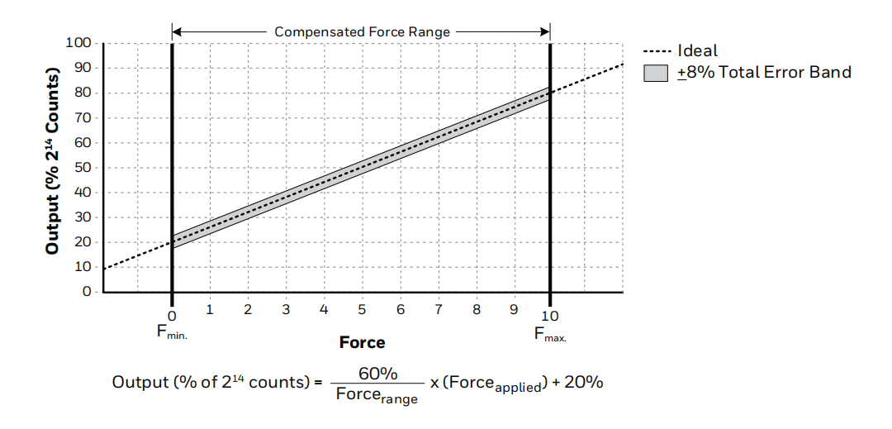
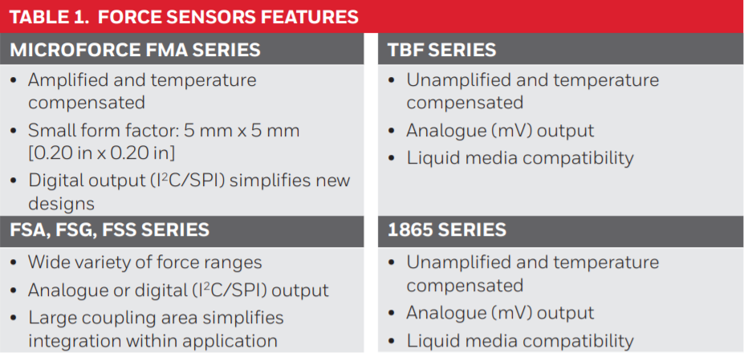
FORCE SENSORS
Monitor the delivery of fluids, medicines or nutrients to the patient.
Detect blockages and determine when the bag containing fluids or nutrients needs to be changed
Used in a non-invasive manner and require no disinfection or sterilisation before reuse.

Slide 5
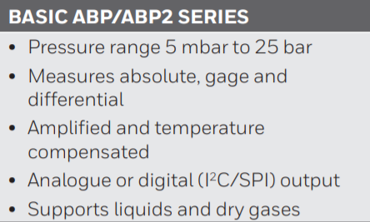
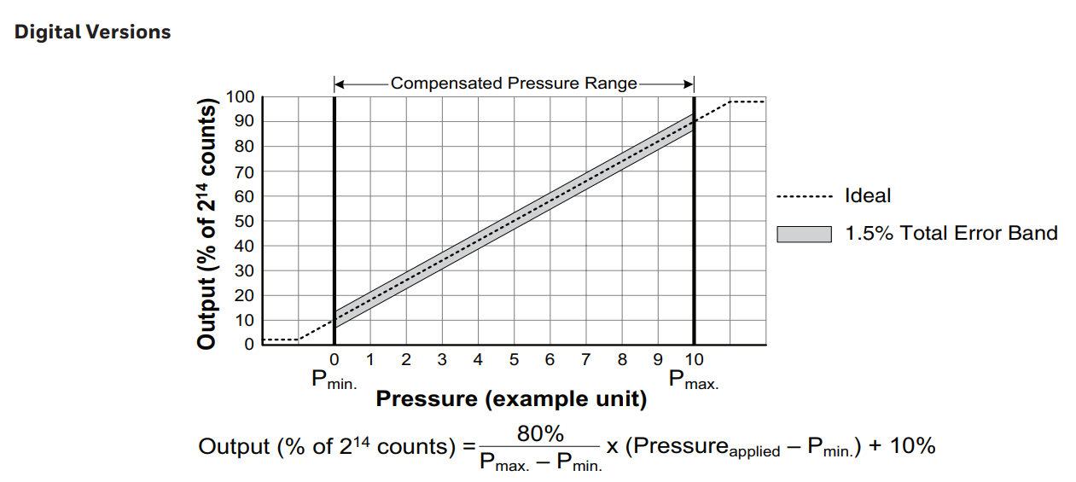
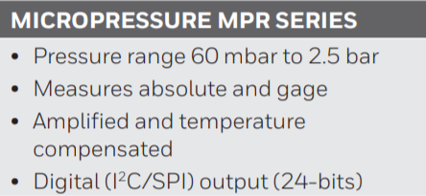
PRESSURE SENSORS
Monitor and control peristaltic pump.
Provides high levels of accuracy, sensitivity and reliability.
Low-power consumption.
Analogue/Digital (I²C/SPI) output

Slide 6
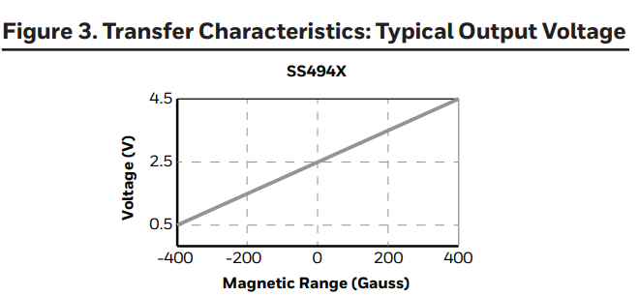
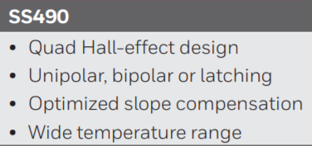
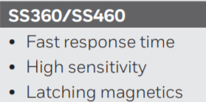
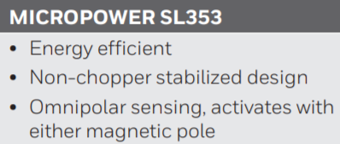
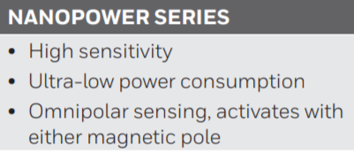
MAGNETIC POSITION SENSOR
Monitior placement of tube in pump cavity to ensure orientation along with pump motor speed control.
Provide more accurate output and reduces noise and vibration with smooth motor control.
Highly reliable, therefore reduces repair and maintenance costs.
Consistent operation over the full temperature range.

Slide 7
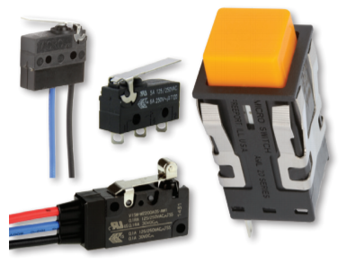
BASIC AML SWITCHES
Switches for on/off operator controls
Detect covers/panels
prevent pump from operating when its not fully closed
Different models:
ZD Series – uses pin plunger as an actuator
ZW Series – uses lever as an actuator

Slide 8
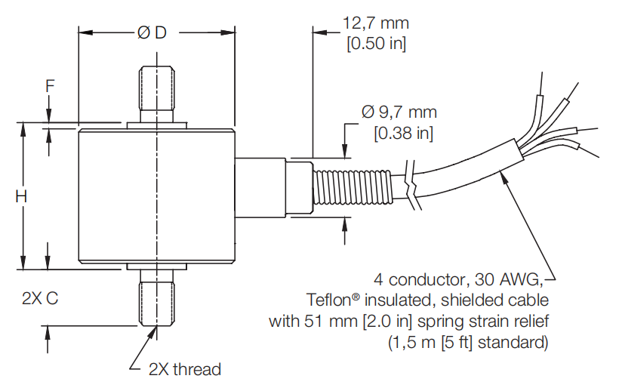
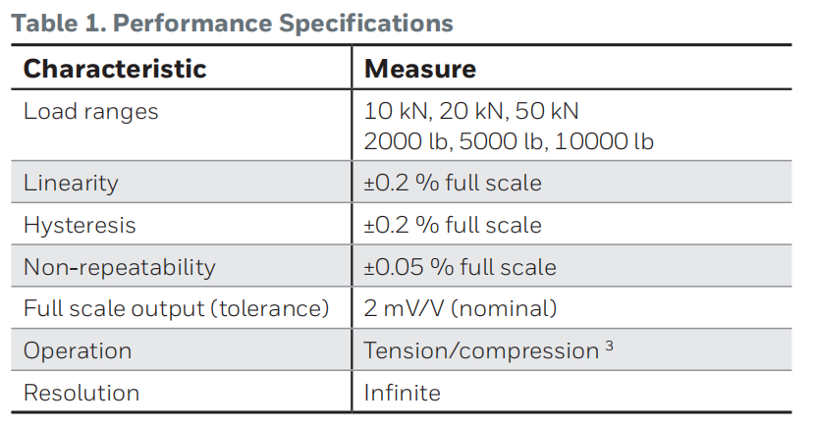
SUBMINIATURE LOAD CELLS
Detemines how much fluid remains in the feeding bag by monitoring the weight.
Model 31 High:

Slide 9
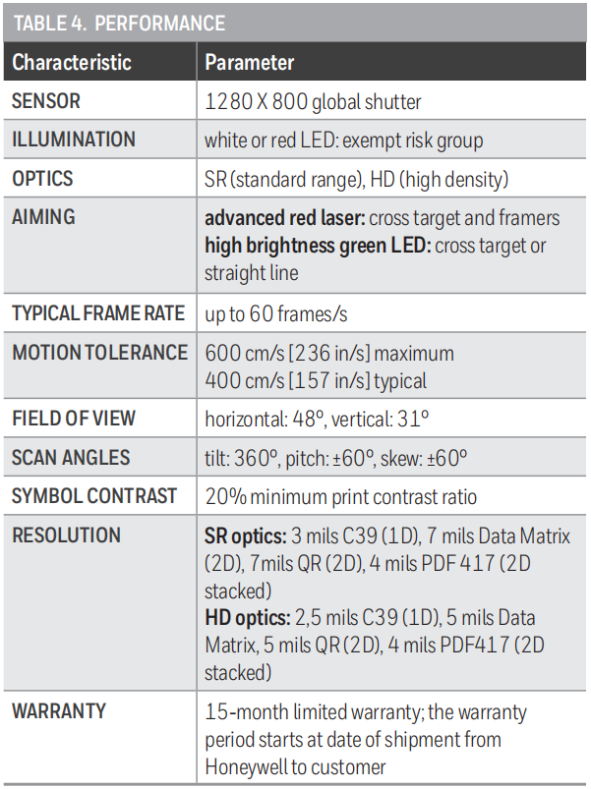
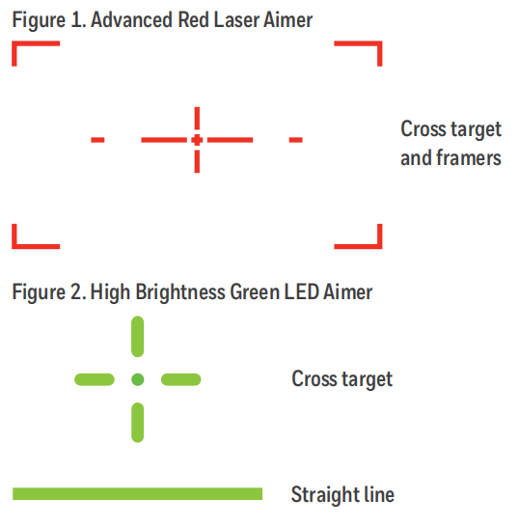
BARCODE SCAN ENGINES & SOFTWARE
Read the barcode and make sure the suitable treatment is used to treat the patient
N670X Series 2D Scan Engines:

Slide 10
REFERENCES
Sensors for infusion pump - https://sensing.honeywell.com/SIOT-Solutions-Infusion-Pumps-_008045-10-EN.pdf
Force Sensors, Basic ABP Series - https://sensing.honeywell.com/honeywell-sensing-basic-board-mount-pressure-abp-series-datasheet-32305128-en.pdf
MicroForce FMA Series Force Sensors Datasheet - https://sensing.honeywell.com/honeywell-sensing-force-fma-series-datasheet-32347833.pdf
Magnetic position sensors,SS490 Datasheet - https://sensing.honeywell.com/honeywell-sensing-sensors-linear-hall-effect-ics-ss490-series-datasheet-005843-2-en.pdf
High Range Precision Miniature Load Cells, Model 31 High datasheet - https://sensing.honeywell.com/honeywell-test-and-measurement-model-31-high-miniature-load-cell-product-sheet-008631-2-en.pdf
N670X Series 2D Scan Engines Datasheet - https://sensing.honeywell.com/honeywell-oem-2d-imagers-n670x-series-datasheet-007613.pdf

Slide 11
Thank you

